Slide 1
Empathic Identification: A Theory of Subjective Agency in Western Art Music
Aubrey Leaman
Northwestern University
aubreyleaman2021@u.northwestern.edu

Slide 3
Empathy’s Role in Music
Musical emotion
Juslin and Västfjäll 2008
Miu and Balteș 2012
Egermann and McAdams 2013
Vuoskoski and Eerola 2017
Enjoyment
Ladinig & Schellenberg 2012
Virtual musical agency
BaileyShea 2012
Hatten 2018
Virtual musical agency:
the ascription of intentional and human-like action, feeling, or thought within music

Slide 4
Argument: Empathy drives agential subjectivity

Slide 5
Hatten’s (2018) hierarchy of virtual musical agency
“a subjectivity” = hierarchical level of agency
“subjectivity” = variety of interpretation

Slide 6
The Problem of Subjectivity
“the process [of attributing agency] is highly subjective—
based on our personal empathic reactions to music—
[so that] there are no commonly recognized strategies
for how to define agency and musical motion”
(BaileyShea 2012)
unchecked
idiosyncrasy

Slide 7
The Problem of Subjectivity
unchecked
idiosyncrasy
“a single listener’s experience will include a play of
various schemes of individuation, none of them
felt as obligatory” (Maus 1988, 68; emphasis original).

Slide 8
The Problem of Subjectivity
unchecked
idiosyncrasy
peripheral
nuance
“negotiated identification”
(Hatten 2018)

Slide 9
The Problem of Subjectivity
empathy
unchecked
idiosyncrasy
peripheral
nuance

Slide 10
Empathic Identification
Definition: empathizing with a highly similar “other” (Preston & de Waal 2002)
Can occur with any hierarchical level

Slide 11
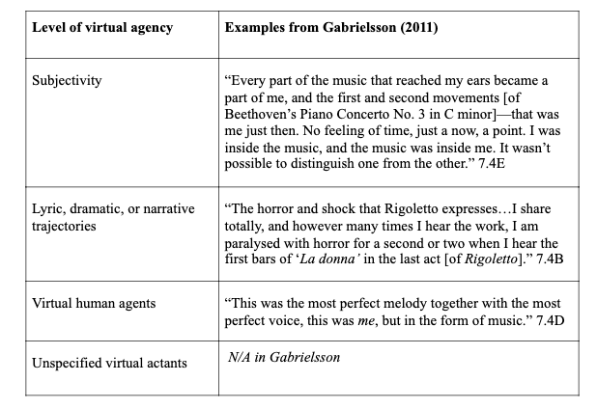

Slide 15
Performer: Murray Perahia

Slide 16
Sergei Rachmaninoff Prelude Op. 3 No. 2

Slide 17
Performer: Arthur Rubinstein
1. Empathic identification
with motive and NOT
accompaniment (actant)
= narrative
2. Empathic identification
with motive AND
accompaniment
= forceful yet unsure
subjectivity
3. Empathic identification
with motive AND
accompaniment
= tragic subjectivity

Slide 18
1. Empathic identification
with agitato
= subjectivity
2. NO empathic
identification with agitato
= reinterpretation of
opening as single agent =
narrative

Slide 19
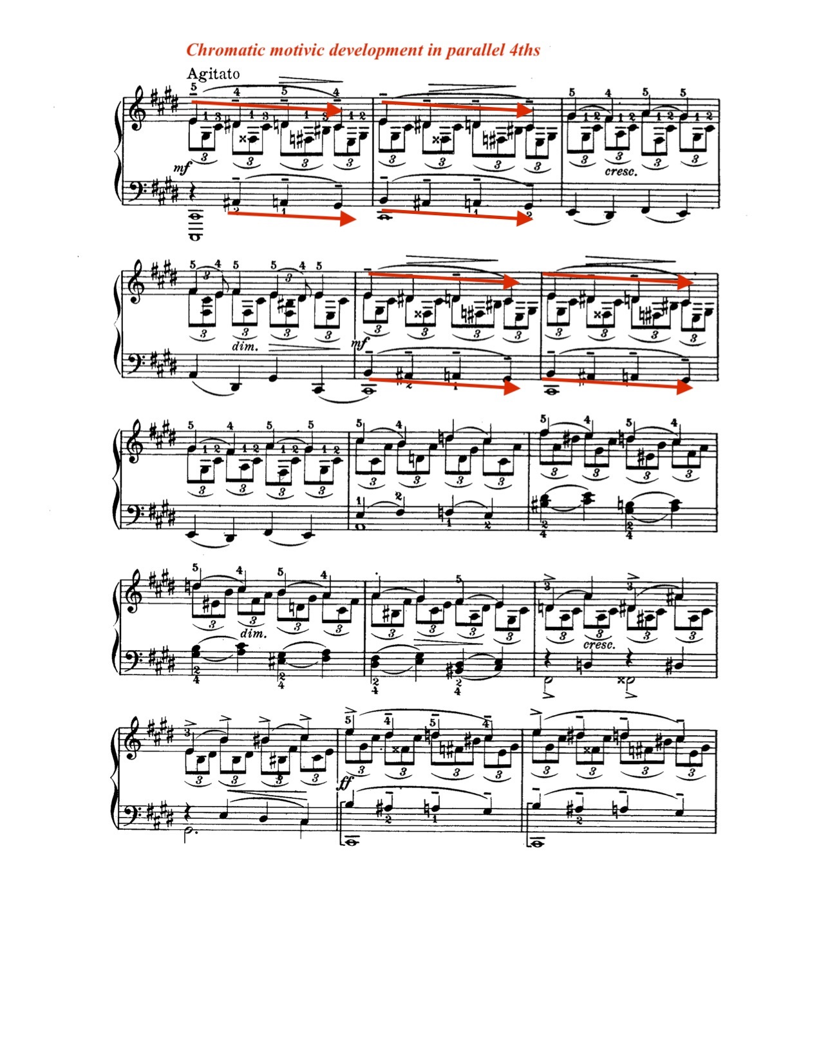

Slide 20
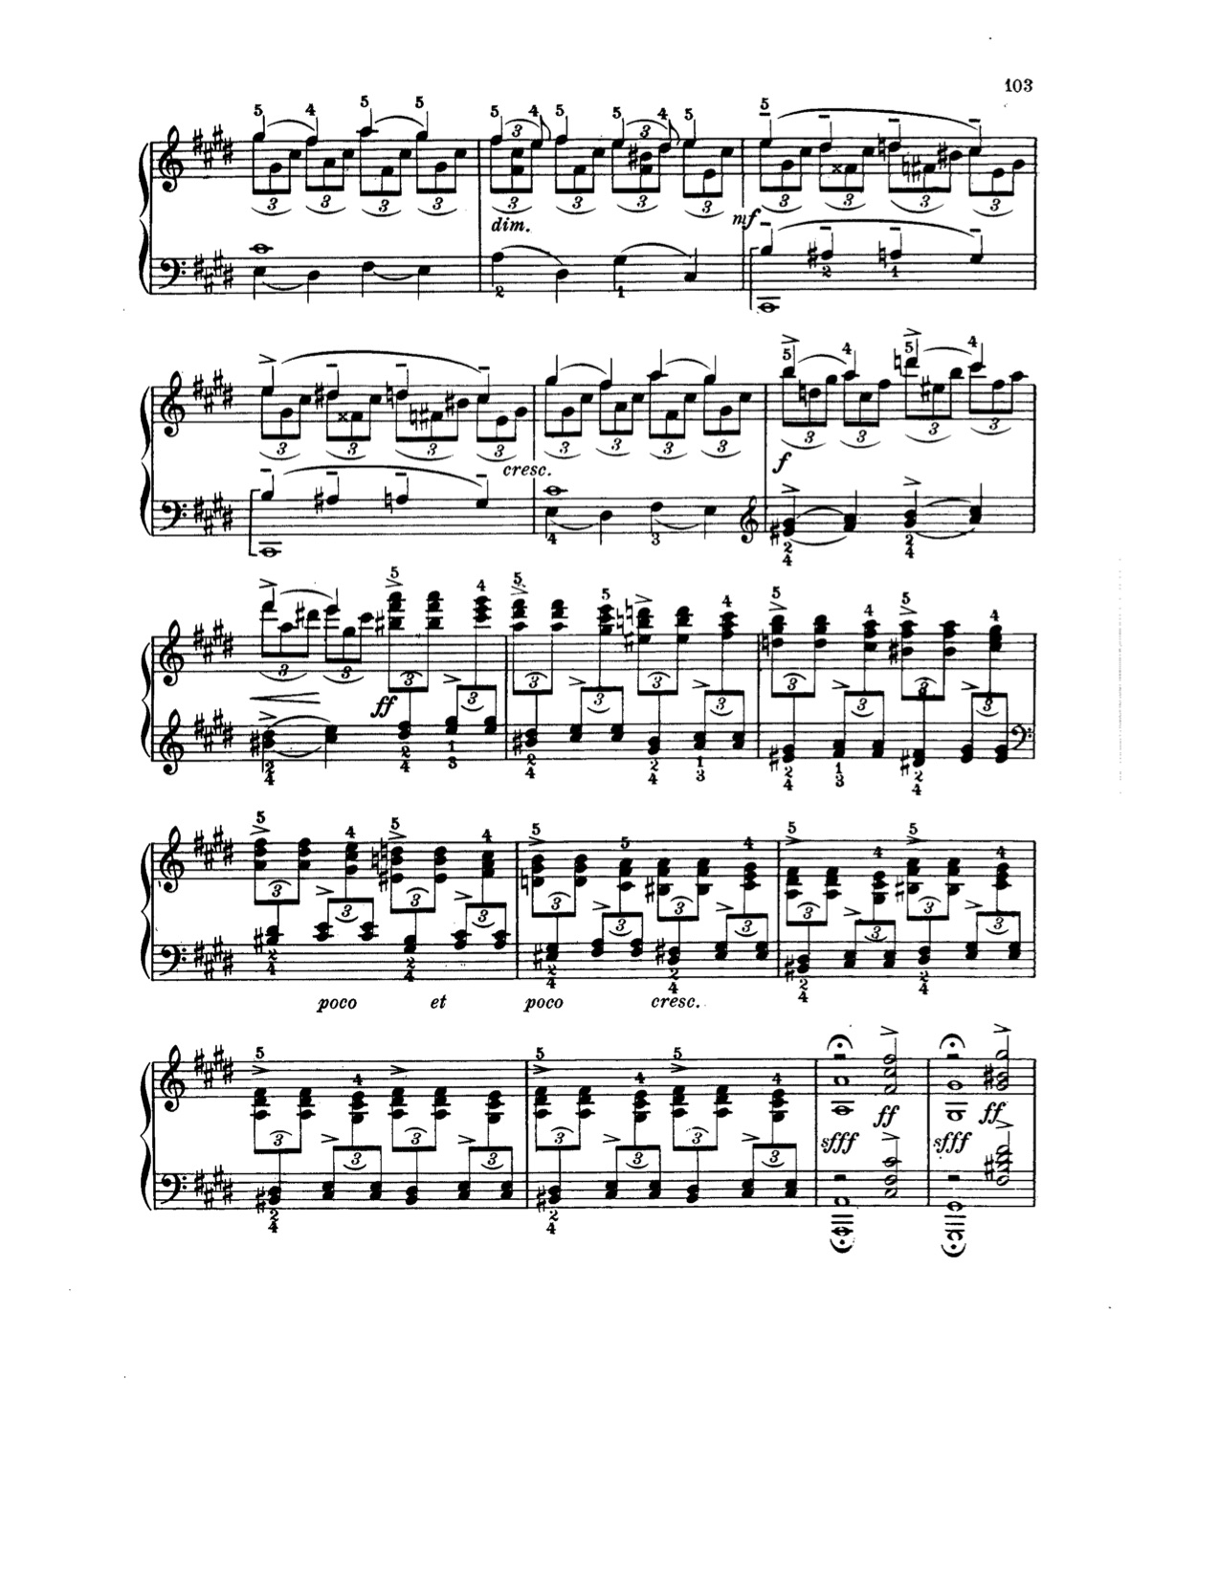

Slide 22
Implications
Subjectivity affects musical interpretation
Empathic identification constrains and explains this subjectivity
Empathic identification can also affect performers and analysts

Slide 23
Thank you!
aubreyleaman2021@u.northwestern.edu

